Slide 1
UofT Engineering Finance Association
Finance 101
Qualitative Analysis
Created By: Garrett Kuhlmann, Ashton Wu
Presented By: Japinder Nijjer – Head Analyst

Slide 2
Recap of Last Week
UTEFA
Financial statements are very important for analysis of a company
Income Statement
Balance Sheet
Statement of Cash Flows
Moving too fast?
Introduction
Company
Industry
Ratios
Conclusion
Notes:
2

Slide 3
Introduction
UTEFA
Need to go over qualitative analysis before quantitative
Today going to talk about some important ratios, as well as strategies that we use in order to find a good company to invest in
Introduction
Company
Industry
Ratios
Conclusion
Notes:
3

Slide 4
Initial Analysis
UTEFA
One of the first things we look for is the companies Business Model
Business model is how the company plans to make money
What makes our company more competitive than its competitors?
What market is our company in?
Introduction
Company
Industry
Ratios
Conclusion
Notes:
4

Slide 5

The Company
Finisar Corp
FNSR (NASDAQ & NYSE)
Introduction
Company
Industry
Ratios
Conclusion
Notes:
5

Slide 6
Company Description
World’s largest supplier of optical communication components and subsystems
Produces products that enable high-speed voice, video and data communications for networking, storage, wireless, and cable TV applications
Major Products: transceivers/transponders, active cables, and optical components
Introduction
Company
Industry
Ratios
Conclusion
Notes:
6

Slide 7
Competitive Advantage
Vertically integrated company
Industry’s broadest product line
Have been in the industry since the 1990s and pioneered VCSEL technology
Introduction
Company
Industry
Ratios
Conclusion
Notes:
7

Slide 8
The Industry
UTEFA
Just as important as the company, is the Industry they work in
Learning about the industry the company operates in gives us a better understanding of the company’s financial position
Customers, market share, industry growth, competition
Introduction
Company
Industry
Ratios
Conclusion
Notes:
8

Slide 9
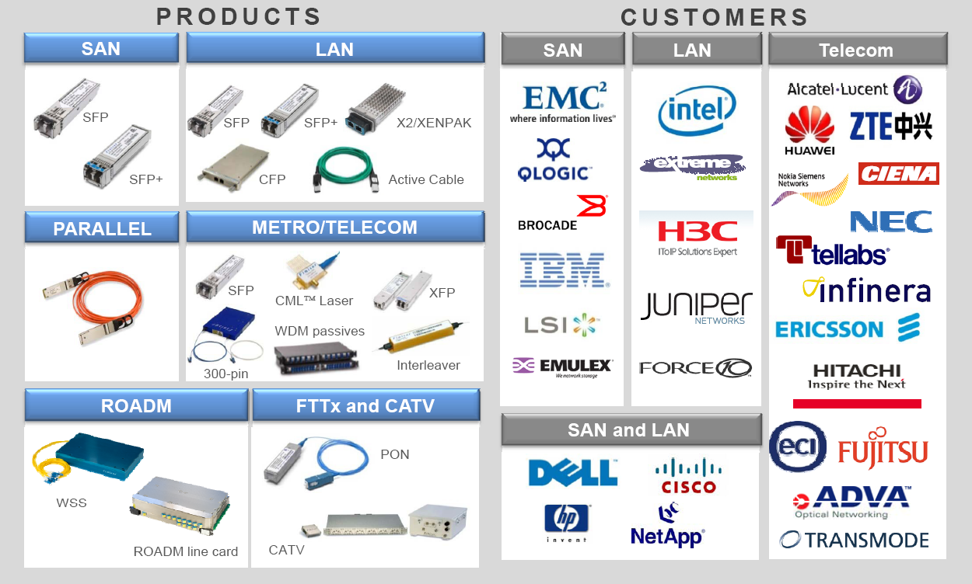
Products and Customers
Introduction
Company
Industry
Ratios
Conclusion
Notes:
9

Slide 10
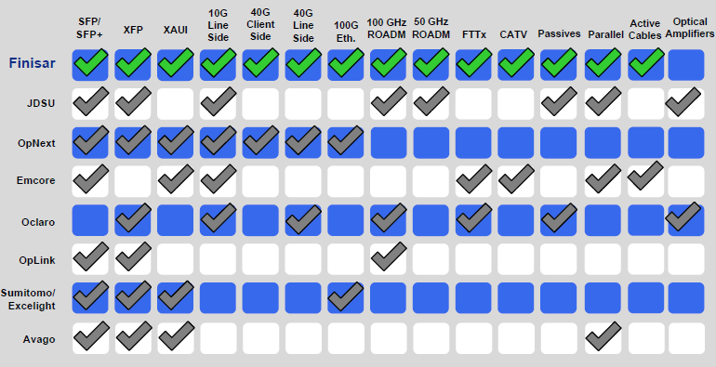
Competitors
Introduction
Company
Industry
Ratios
Conclusion
Notes:
10

Slide 11
Market Share
Company | Market Capitalization | Share Price
Finisar | 1.53B | 16.84
JDSU | 2.05B | 8.99
OpNext | 106.55M | 1.18
Emcore | 81.15M | 0.87
Oclaro | 164.22M | 3.26
OpLink | 279.31M | 14.30
Avago | 7.83B | 31.89
Introduction
Company
Industry
Ratios
Conclusion
Notes:
11

Slide 12
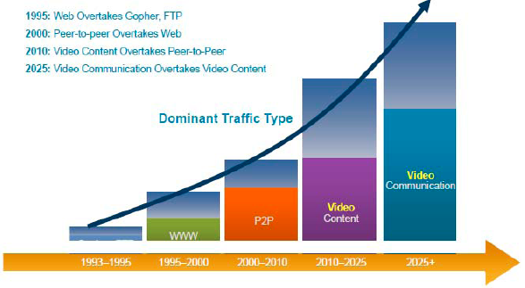
Industry Growth
Introduction
Company
Industry
Ratios
Conclusion
Notes:
12

Slide 13
Industry Growth
Growth driven by need for increased bandwidth
Business and consumers are moving towards cloud computing
Businesses are moving to wireless networking to increase efficiency
Introduction
Company
Industry
Ratios
Conclusion
Notes:
13

Slide 14
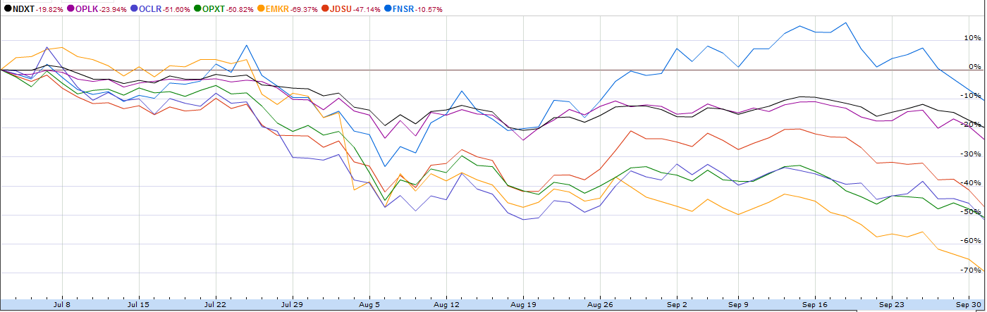
Charting of Competitors
Introduction
Company
Industry
Ratios
Conclusion
Notes:
14

Slide 15
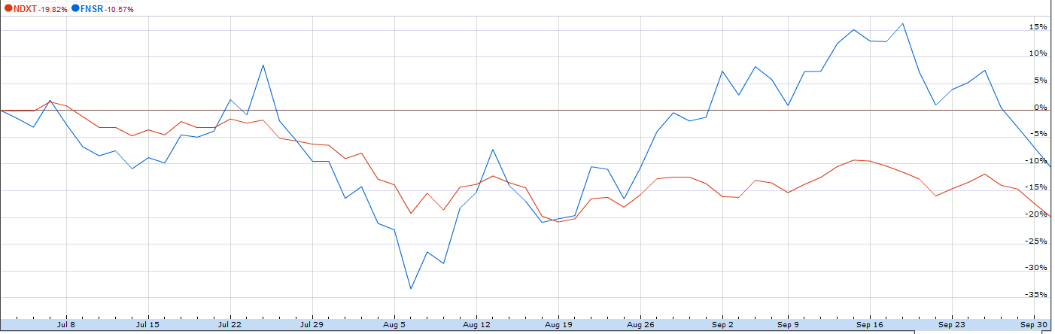
3 Month Charting
Introduction
Company
Industry
Ratios
Conclusion
Notes:
15

Slide 16
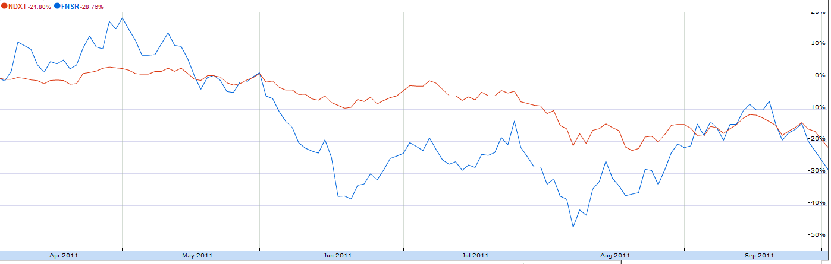
6 Month Charting
Introduction
Company
Industry
Ratios
Conclusion
Notes:
16

Slide 17
Qualitative Checklist
UTEFA
History and Current State
Business Plan
Management
Products or Services
Competitors (Type of quantitative analysis)
Financial Ratios
Important Financial Statement Figures
Stock Price Trends
Analyst Recommendations
Recent News
Introduction
Company
Industry
Ratios
Conclusion
Notes:
17

Slide 18
Ratios
Looking at a companies financial ratios gives us an idea of what kind of financial position they are in, without going into an in-depth financial analysis
Comparing different ratios with competitors gives us a sense of how each company is doing
In many cases, you can find simple ratios on finance websites
Introduction
Company
Industry
Ratios
Conclusion
Notes:
18

Slide 19
Ratios
All we do with ratios is compare different accounts from a companies financial statements
Gives us an idea of a companies:
Liquidity
Profitability
Debt situation
Operating Performance
Ect.
Introduction
Company
Industry
Ratios
Conclusion
Notes:
19

Slide 20
Ratios
We will cover a few ratios from important categories:
Liquidity: Current Ratio
Profitability: Profit Margin, Return on Equity
Debt: Debt/Equity Ratio
Investment: P/E Ratio, EPS
Introduction
Company
Industry
Ratios
Conclusion
Notes:
20

Slide 21
Liquidity
Current Ratio=Current Assets/Current Liabilities
Tells us how easily a company can cover it’s short term debt
A company with a low current ratio compared to its competitors should raise alarm
Introduction
Company
Industry
Ratios
Conclusion
Notes:
21

Slide 22
Profitability
Net Profit Margin=Net Income/Revenue
With this ratio, you can look at how their profit margin has grown/decreased over time
A company with decreasing profit margins indicates their industry is becoming more competitive
Introduction
Company
Industry
Ratios
Conclusion
Notes:
22

Slide 23
Profitability
Return on Equity=Net Income/Average Equity
“average equity” since over time shareholder equity changes
RoE tells average shareholders how well their money is being used
Kind of deceiving since companies may finance through debt as well
Introduction
Company
Industry
Ratios
Conclusion
Notes:
23

Slide 24
Debt
Debt to Equity = Total Liabilities/Equity
Give the investor an idea of how the company is leveraging itself
Not pure: includes operational debt like accounts payable and taxes payable
Watch out for companies that are highly leveraged compared to their competitors
Introduction
Company
Industry
Ratios
Conclusion
Notes:
24

Slide 25
Investment
PE Ratio = Price per share/Earnings per share
EPS – some ambiguity in that metric
PE ratio used extensively
High PE ratio should mean high growth stock
Could mean overvalued stock as well!
Introduction
Company
Industry
Ratios
Conclusion
Notes:
25

Slide 26
Investment
Earnings Per Share = (Net Income – Dividends)
Average Shares
Investors look for high EPS relative to competitors
May be forward looking, or EPS from the past year
That is where ambiguity arises
Introduction
Company
Industry
Ratios
Conclusion
Notes:
26

Slide 27
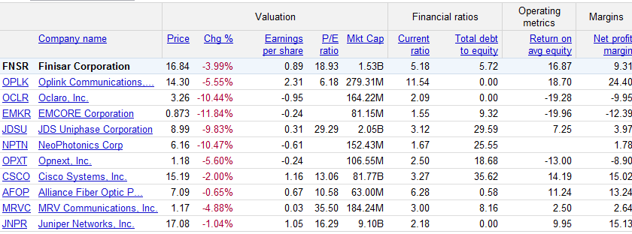
Ratios
Introduction
Company
Industry
Ratios
Conclusion
Notes:
27

Slide 28
Conclusion
UTEFA
Using resources such as a companies 10-k filing will help determine the market outlook for the future
We can also rely on analysts
Research on a company and its industry will provide great insight into operations before we look at the Quantitaive Analysis
Introduction
Company
Industry
Ratios
Conclusion
Notes:
28

Slide 29

Should we invest in Finisar?
Notes:
29

